Slide 1
Rating Prediction Benchmarks
Project Presentation
Mert Burak Burabak

Slide 2
About Project
Creating a recommender system with explicit feedback data on the [1-5] scale is a frequently discussed topic in the literature. In this regard, researchers enrich the literature with their approach and solution methods. In recent years, the number of deep learning approaches has increased significantly and its influence in the recommender system domain is increasing day by day. It is especially valuable in that it can process different types of data together, optimize multiple tasks at the same time, and capture non-linear connections. While most researches use very rich data in terms of customers and products features, in this study, only rating are used.
In this study, our aim was to investigate whether deep learning methods have an algorithmic advantage over classical methods. We studied 2 traditional methods and 2 deep learning methods. We compared these methods using ranking metrics methods on different datasets.

Slide 3
Agenda
About Projects
Methods
Datasets
Experiment Setup
Experiment Results
Conclusion
References

Slide 4
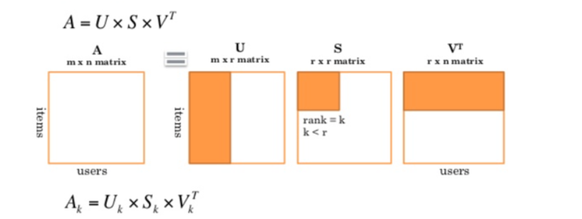
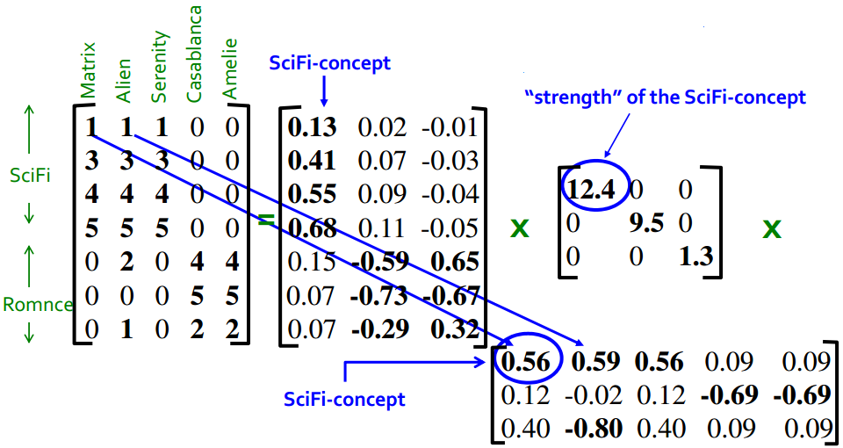
Methods
Singular Value Decomposition (SVD)

Slide 5
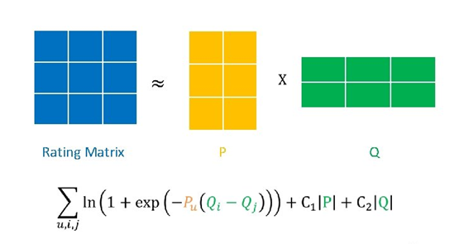
Methods
Bayesian Personalized Ranking (BPR)
Rendle, S., Freudenthaler, C., Gantner, Z., & Schmidt-Thieme, L. (2009). Bpr: bayesian personalized ranking from implicit feedback
https://arxiv.org/abs/1205.2618

Slide 6
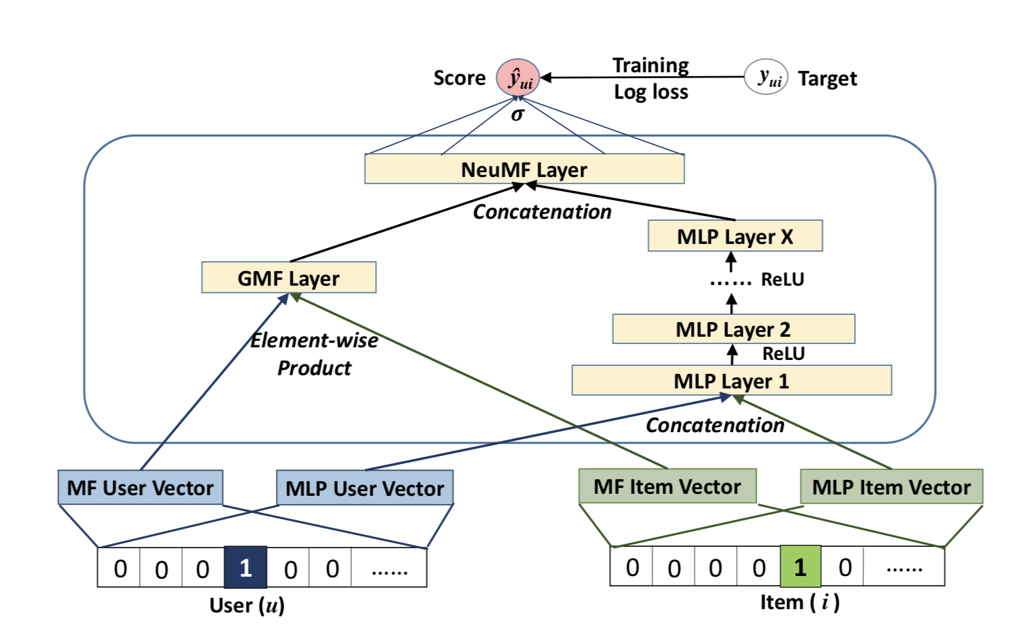
Methods
Neural Collaborative Filtering(NeuMF)
Xiangnan He, Lizi Liao, Hanwang Zhang, Liqiang Nie, Xia Hu, Tat-Seng Chua (2017). Neural Collaborative Filtering
https://arxiv.org/abs/1708.05031

Slide 7
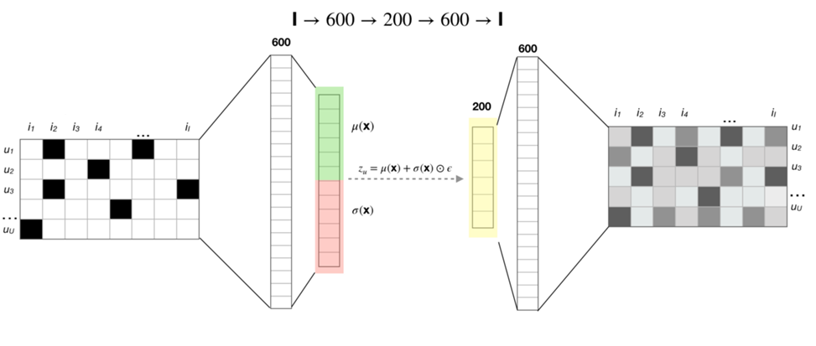
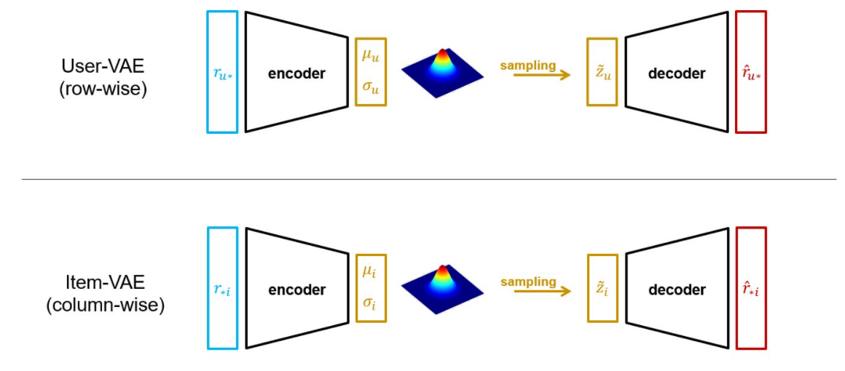
Methods
Bilateral VAE for Collaborative Filtering (BiVAECF)
First: Variational Autoencoders for Collaborative Filtering(VAECF)
Dawen Liang, Rahul G. Krishnan, Matthew D. Hoffman, Tony Jebara (2018). Variational Autoencoders for Collaborative Filtering
«One plausible explanation for the good results achieved by VAE on the CF task is its probabilistic nature. Indeed, the key difference of this model with neural networks is that VAE does not seek to learn deterministic representations, but rather learns distributions over these representations, thereby allowing it to account for uncertainty in the latent space. That property is particularly beneficial when dealing with sparse data where few observations are available.» - Microsoft Recommenders
Notes:
https://github.com/microsoft/recommenders/blob/main/examples/02_model_collaborative_filtering/cornac_bivae_deep_dive.ipynb

Slide 8
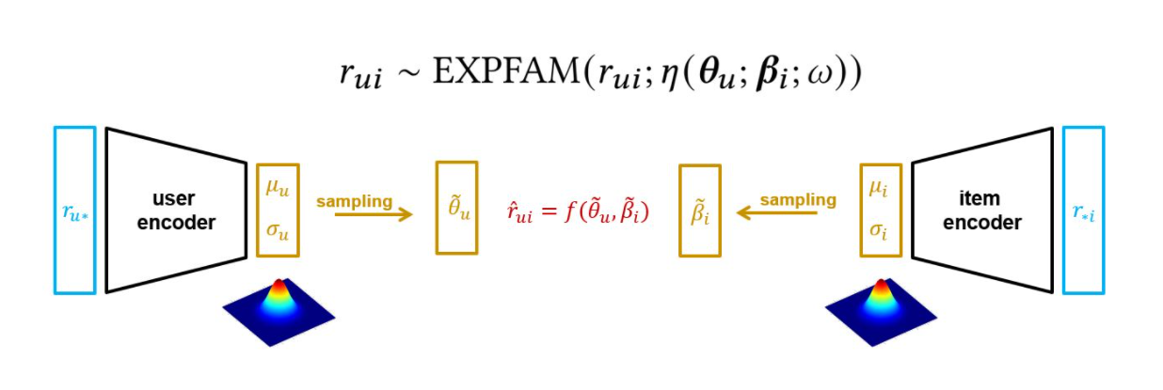
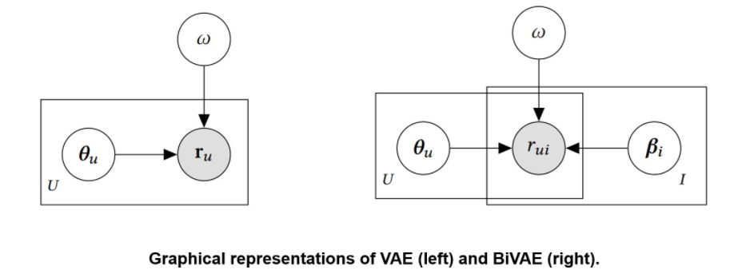
Methods
Bilateral VAE for Collaborative Filtering (BiVAECF)
Quoc Tuan Truong, Aghiles Salah, Hady W. Lauw (2021). Bilater Bilateral variational aut ariational autoencoder for collabor oencoder for collaborative filtering
https://ink.library.smu.edu.sg/cgi/viewcontent.cgi?article=6955&context=sis_research

Slide 9
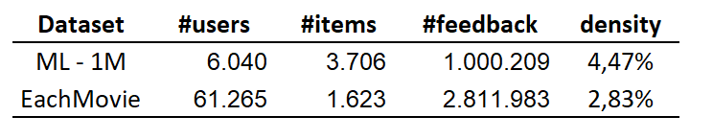
Datasets
EachMovie
- Columns: user_id, item_id, score, timestamp
- Score scale: {0, 0.2, 0.4, 0.6, 0.8, 1.0}
rating = score * 5
https://grouplens.org/datasets/eachmovie/
MovieLens – 1M
- Columns: user_id, item_id, rating, timestamp
- Rating scale: [1,5]
https://grouplens.org/datasets/movielens/

Slide 10
Experiment Setup
Datasets
Train: %75, Test: %25, randomly
Evaluation Metrics
For K in [10, 50, 100]:
MAP@K, NDCG@K, Precision@K, Recall@K

Slide 11
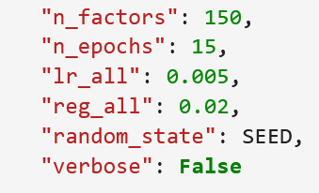
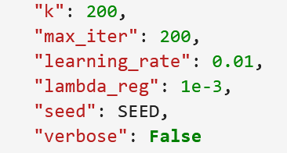
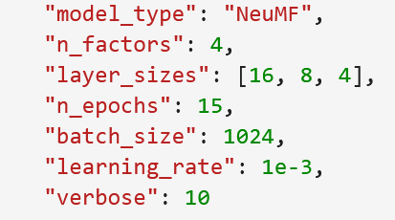
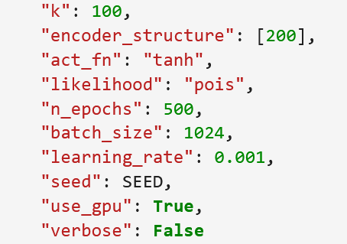
Experiment Setup
Experimental Settings
SVD:
Used library: surprise
BPR:
Used library: cornac
NeuMF:
Used library: Microsoft Recommenders
BiVAECF:
Used library: cornac

Slide 12
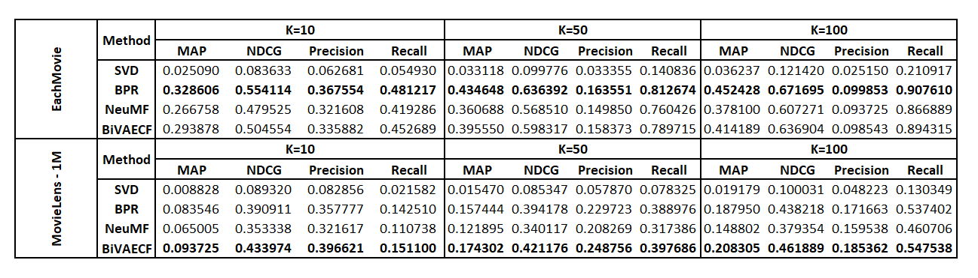
Experiment Results

Slide 13
Conclusion
In this study, we tried to evaluate the algorithmic advantages and performances of classical methods and deep learning approaches. As a result of our experiments, the prominent method in different datasets has changed. BiVAECF outperformed the MovieLens dataset, while BPR outperformed the EachMovie dataset.
Since BiVAECF optimizes on the distribution of vectors probabilistically rather than deterministically, it outperforms NeuMF, which tries to make deterministic estimations.
BPR, which performs ranking optimization due to its structure, outperformed SVD, which tried to deterministically estimate rating.
We can conclude that, according to the data we have, deep learning approaches and methods we call classical methods can show different performances. By trying different methods, we should choose our method according to the results of our experiments.

Slide 14
References
https://arxiv.org/abs/1205.2618
https://arxiv.org/abs/1708.05031
https://ink.library.smu.edu.sg/cgi/viewcontent.cgi?article=6955&context=sis_research
https://grouplens.org/datasets/movielens/
https://grouplens.org/datasets/eachmovie/
https://cornac.readthedocs.io/en/latest/
https://github.com/microsoft/recommenders
https://github.com/NicolasHug/Surprise

